Slide 1
How to integrate blockchain technology to businesses
Professor Fatih Ozaydin
fatih@tiu.ac.jp

Slide 2
Outline
Brief introduction to Blockchain
Background
Essentials
Blockchain in Business
Cons, Threats & Solutions

Slide 3
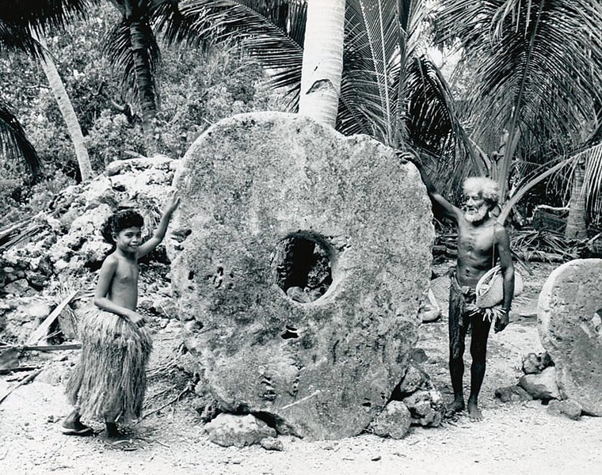
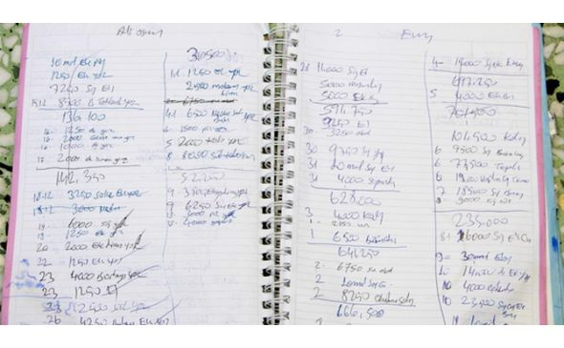
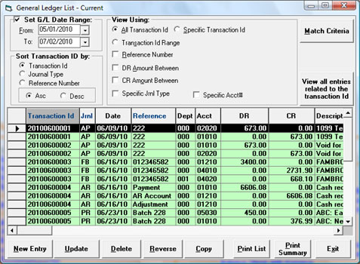
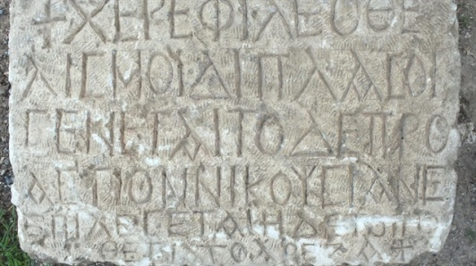
Background
Assets
Tangible: Has physical form
e.g. stones, land, buildings
Intangible: No physical (solid) form
e.g. digital, intellectual
Ledger
To record the transfer of assets
Yap Stone. img src:

Slide 4
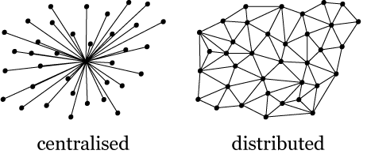
Background
Ledger:
Centralized
Distributed (shared)
Each node keeps a copy
Requires technology, e.g. Cryptography and effort

Slide 5
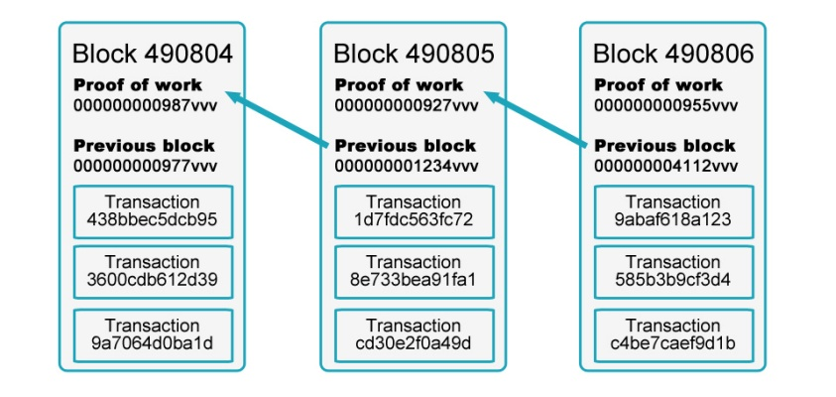
Background
An append-only distributed ledger
Transaction Records are stored in blocks
Blocks form a chain: The Ledger
Each node has a copy of the ledger:
Consensus required (longest chain)
Permisionless
Permissioned
With mining: Proof of Work
Without Mining: Proof of Stake, Practical Byzantine Fault Tolerance

Slide 6
With mining: Proof of Work
Miners: Peers that maintain and update the Blockchain
Solve a complex mathematical problem (cryptography)
Send transactions to other nodes for verification
Paid a reward (such as, some Bitcoin)
If all miners agree on solution → Block is added to Chain

Slide 7
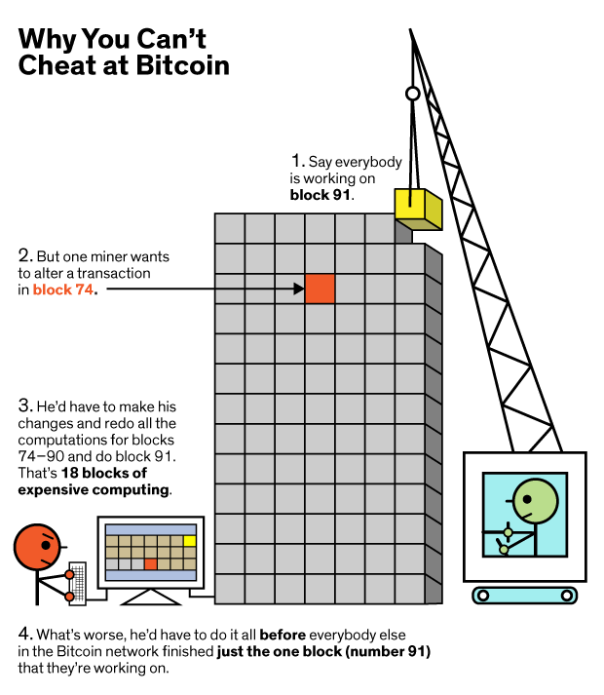
Security
Immutable:
Write & Read-Only
Illustration: Mark Montgomery, IEEE Spectrum

Slide 8
Blockchain
A system consisting of
Transactions
Immutable Ledgers
Distributed (decentralized) Peers
Encryption Processes
Consensus Mechanisms
(Optional) Smart Contracts ?

Slide 9
Smart Contracts
Aims to minimize the requirement of “trust”
Actually, neither ‘smart’, nor ‘contract’
Software, deployed onto a Blockchain
Transaction instructions triggered by events
If X, then Y
Example
If the tuition fee is paid, then approve the registration
Agreements follow If-then logic,
Can be replaced with Smart Contracts!

Slide 10
Blockchain Applications
Cryptocurrencies
Bitcoin,
Altcoins: Ripple, Ethereum, Monero, Zcash, etc.
Managing Transactions in Business; can improve
procure-to-pay,
accounts receivable
accounts payable,
general ledger,
reconciliation,
payroll

Slide 11
Business Blockchains
Set up by
A single company or
A group of specified & known companies
Does it make sense for our business?
Number of participants
Complexity of business
Long-term record keeping & regulatory compliance
Real-time transfer of assets or payments

Slide 12
Real Life Business Blockchain Examples
Retail
Warranteer, Blockpoint, Loyyal
Supply Chains and Logistics
IBM Blockchain, Provenance, Blockverify, OriginTrail
Insurance
Accenture
Healthcare
MedicalChain, MedRec, Gem
Real Estate
BitProperty, Deedcoin (1% Comission)

Slide 13
How to integrate Blockchain to our Business
9-Component Framework by HashEx
1. Business Objective
2. Benefits
3. Concept
4. Architecture
Consensus Rules,
Data Privacy, outsider?
Complexity of executable algorithms

Slide 14
5. Roadmap
Description of Minimum Viable Product (MVP)
MVP vs fully functional product
Platform selection for MVP implementation
Prototyping
Prototype viability check
Describing the fully functional product
Selecting the platform
Implementation

Slide 15
6. Minimum Viable Product (MVP)
7. MVP vs Fully Functional Product
8. Prototype
9. Cases

Slide 16
Applications
Smart Contracts (Ethereum)
Paying Employees (BitWage)
Electronic Voting (BitShares)
IBM Blockchain
Creating own cryptocurrency
Possibly using CryptoLife, WalletBuilders, etc.

Slide 17
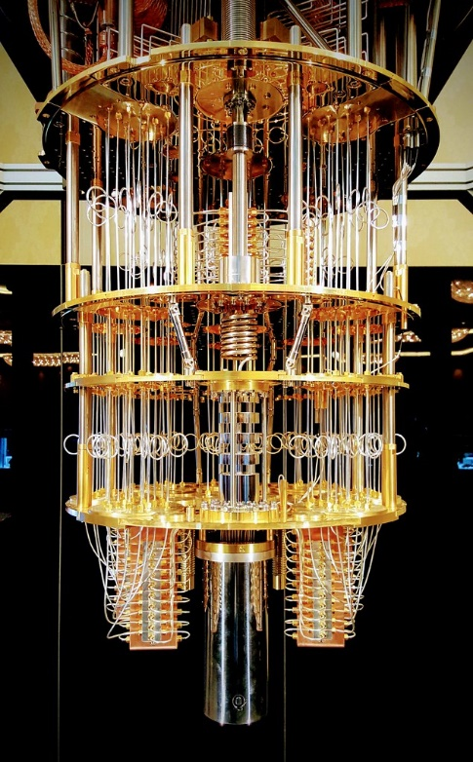
Cons, Threats, Solutions & Opportunities
Security depends on complex mathematical functions
Difficult to solve (for classical computers)
Mining requires computational power (electricity)
BitCoin Currently consuming ~3 GWatts/year (~ Ireland)
Motivation to hack others’ computers & servers
Easy to solve for Quantum Computers
A serious threat in ~10 years time
Solution to both security & environmental issues:
Quantum Blockchain
Opportunity: New Science Minister, Takuya Hirai

Slide 18
Sources & Read More
https://mastanbtc.github.io/blockchainnotes/
https://en.bitcoin.it/wiki/Contract
https://www.forbes.com/sites/bernardmarr/2018/05/14/30-real-examples-of-blockchain-technology-in-practice/
https://tradeix.com/essential-blockchain-technology-concepts/
https://medium.com/hashex-blog/how-to-integrate-blockchain-464d241a6681
http://fortune.com/2017/08/22/walmart-blockchain-ibm-food-nestle-unilever-tyson-dole/
https://bitshares.org/technology/delegated-proof-of-stake-consensus/
https://execed.economist.com/blog/industry-trends/5-applications-blockchain-your-business
https://www.walletbuilders.com/
https://dev.cryptolife.net/
https://hashex.org/
Blockchain Demo: https://anders.com/blockchain/blockchain.html

